Slide 1
International Bureau of Fiscal Documentation (IBFD)

Slide 2
IBFD
75 years young
Independent
More then 40 nationalities in-house
Knowledge Centre with a dedication for training, advising and editing
A well known publisher with an unique Tax Research Platform
Academic credentials
Recognition by IMF, OECD, EU, World Bank, CIAT, CATA, ADB, NGO’s etc
http://www.ibfd.org

Slide 3
What kind of advice can you expect from IBFD?
Tax Policy (the legal, social, international and economic framework of taxation);
Tax Legislation (how to draft primary and secondary legislation in such a way that tax policy principles can be implemented and executed);
Tax Administration (how to organise taxation in such a way that the conditions for compliance are set and that administrative and compliance costs are in control).

Slide 4
Courses for Tax Authorities
Tax policy
Tax administrative reform
Tax evasion and anti-money laundering
Investigation and prosecution
Tax risk management
Compliance and enhanced relationships
E-commerce
Tax reform for countries in transition
Tax treaty negotiations
Transfer pricing principles
Drafting legislation
Tax Gap analyses and Shadow economy

Slide 5
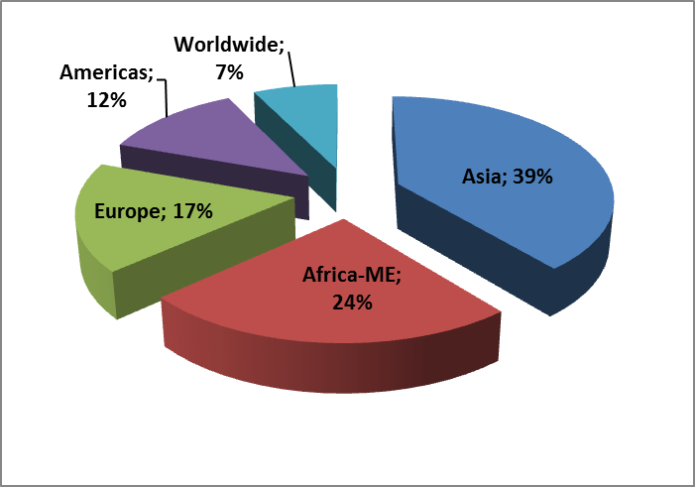
Regional presence in Government consultancy

